Slide 1

Progress Presentation
04-12-2024
Prepared by: Marie Joe Sawma To: Dr. Reed Maxwell

Slide 2
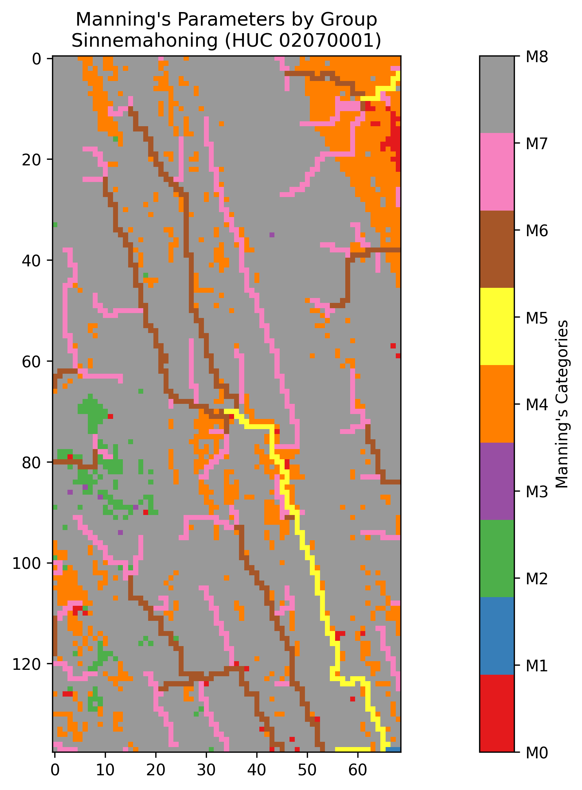
Manning’s Spatial Distribution

Slide 3
Manning’s: Static Input
Manning’s value
M0 | 5.56E-06
M1 | 8.34E-06
M2 | 9.73E-06
M3 | 1.39E-05
M4 | 1.53E-05
M5 | 1.67E-05
M6 | 1.94E-05
M7 | 2.50E-05
M8 | 2.78E-05

Slide 4
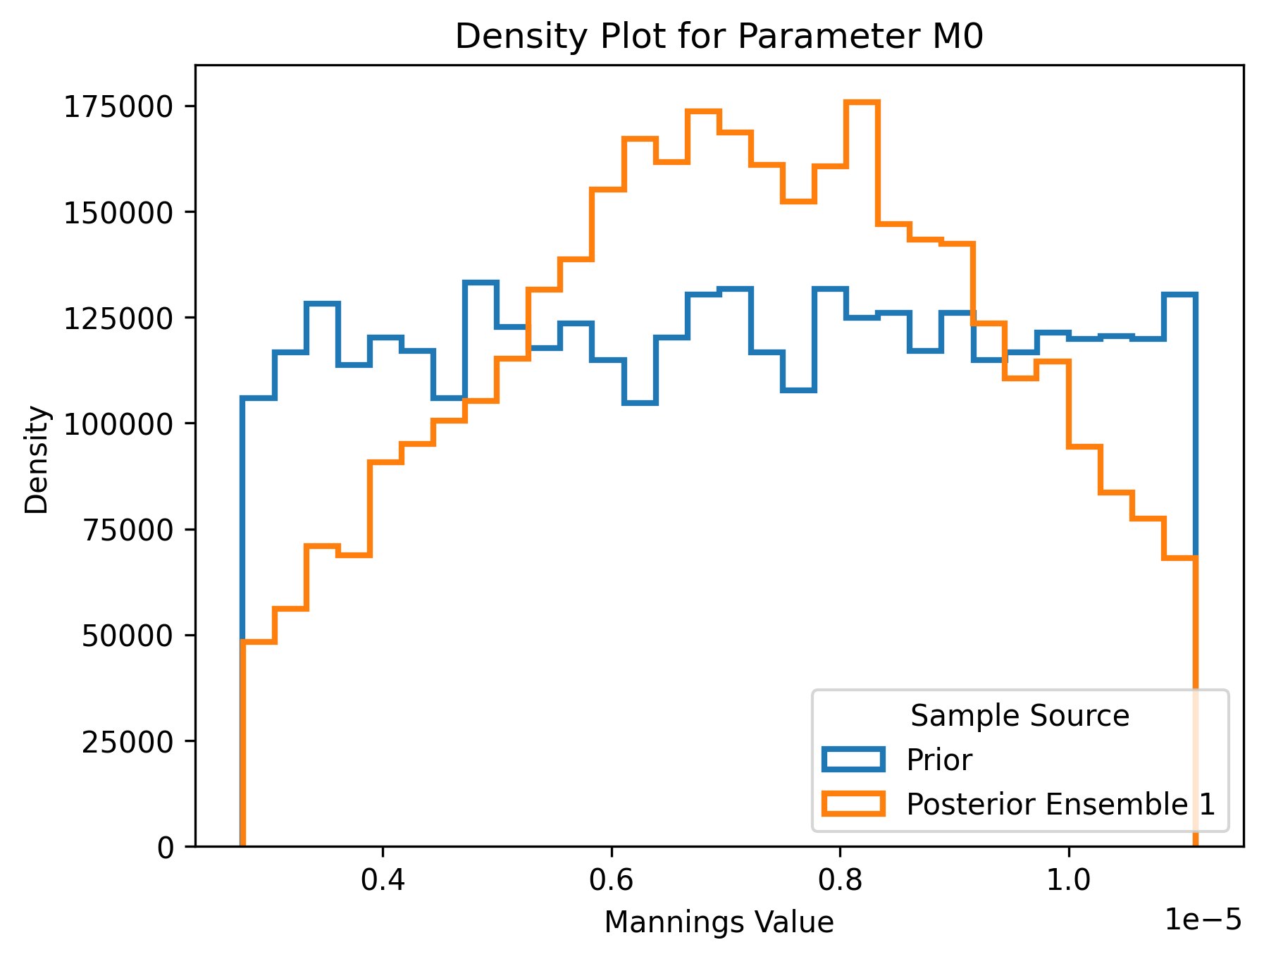
M0: Posterior Distribution
Notes:
Sampling 400 simulations
Posterior distribution that is presented is from the first iteration

Slide 5
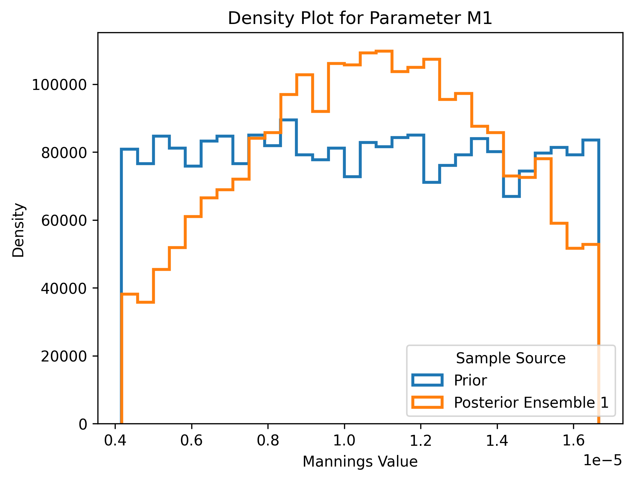
M1: Posterior Distribution
Notes:
Sampling 400 simulations
Posterior distribution that is presented is from the first iteration

Slide 6
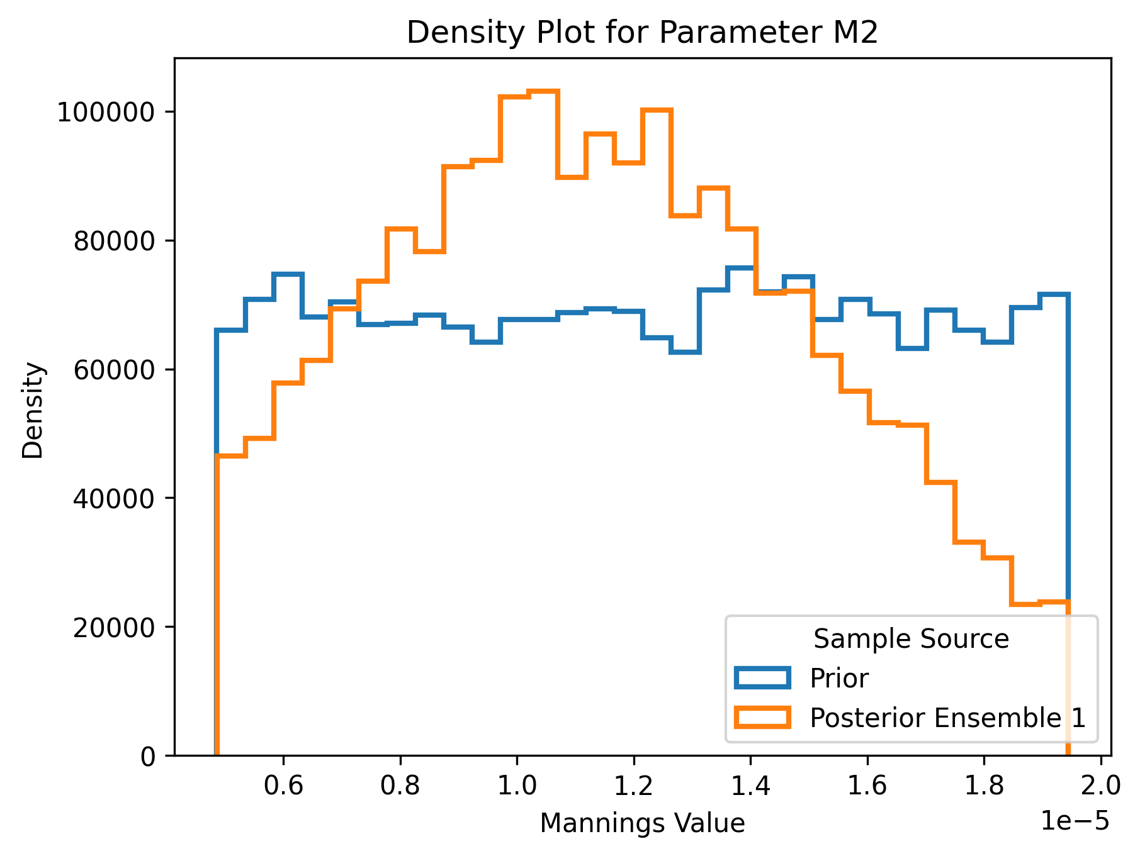
M2: Posterior Distribution
Notes:
Sampling 400 simulations
Posterior distribution that is presented is from the first iteration

Slide 7
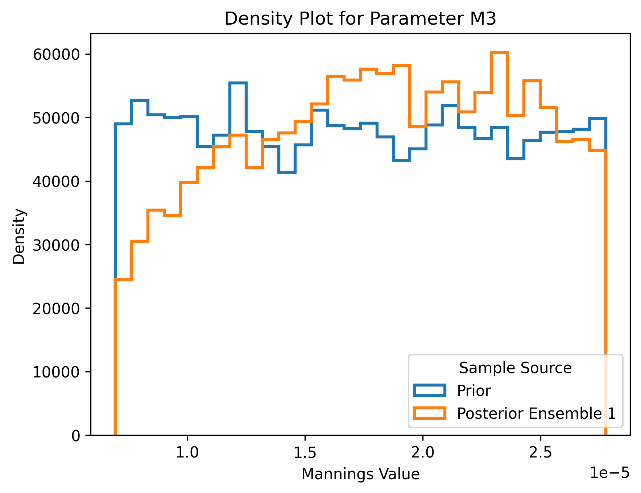
M3: Posterior Distribution
Notes:
Sampling 400 simulations
Posterior distribution that is presented is from the first iteration

Slide 8
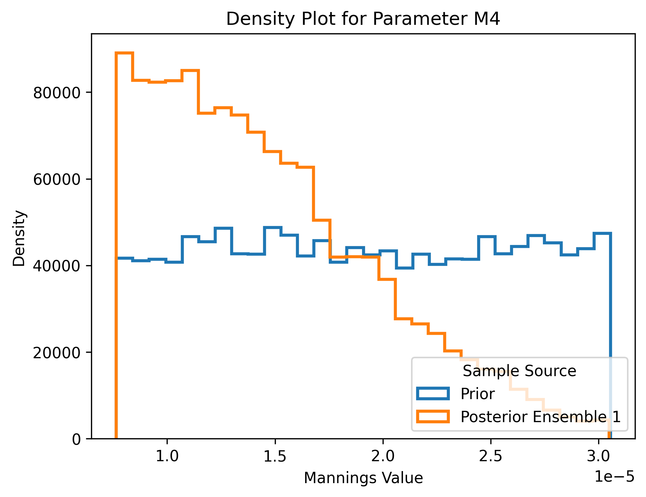
M4: Posterior Distribution
Notes:
Sampling 400 simulations
Posterior distribution that is presented is from the first iteration

Slide 9
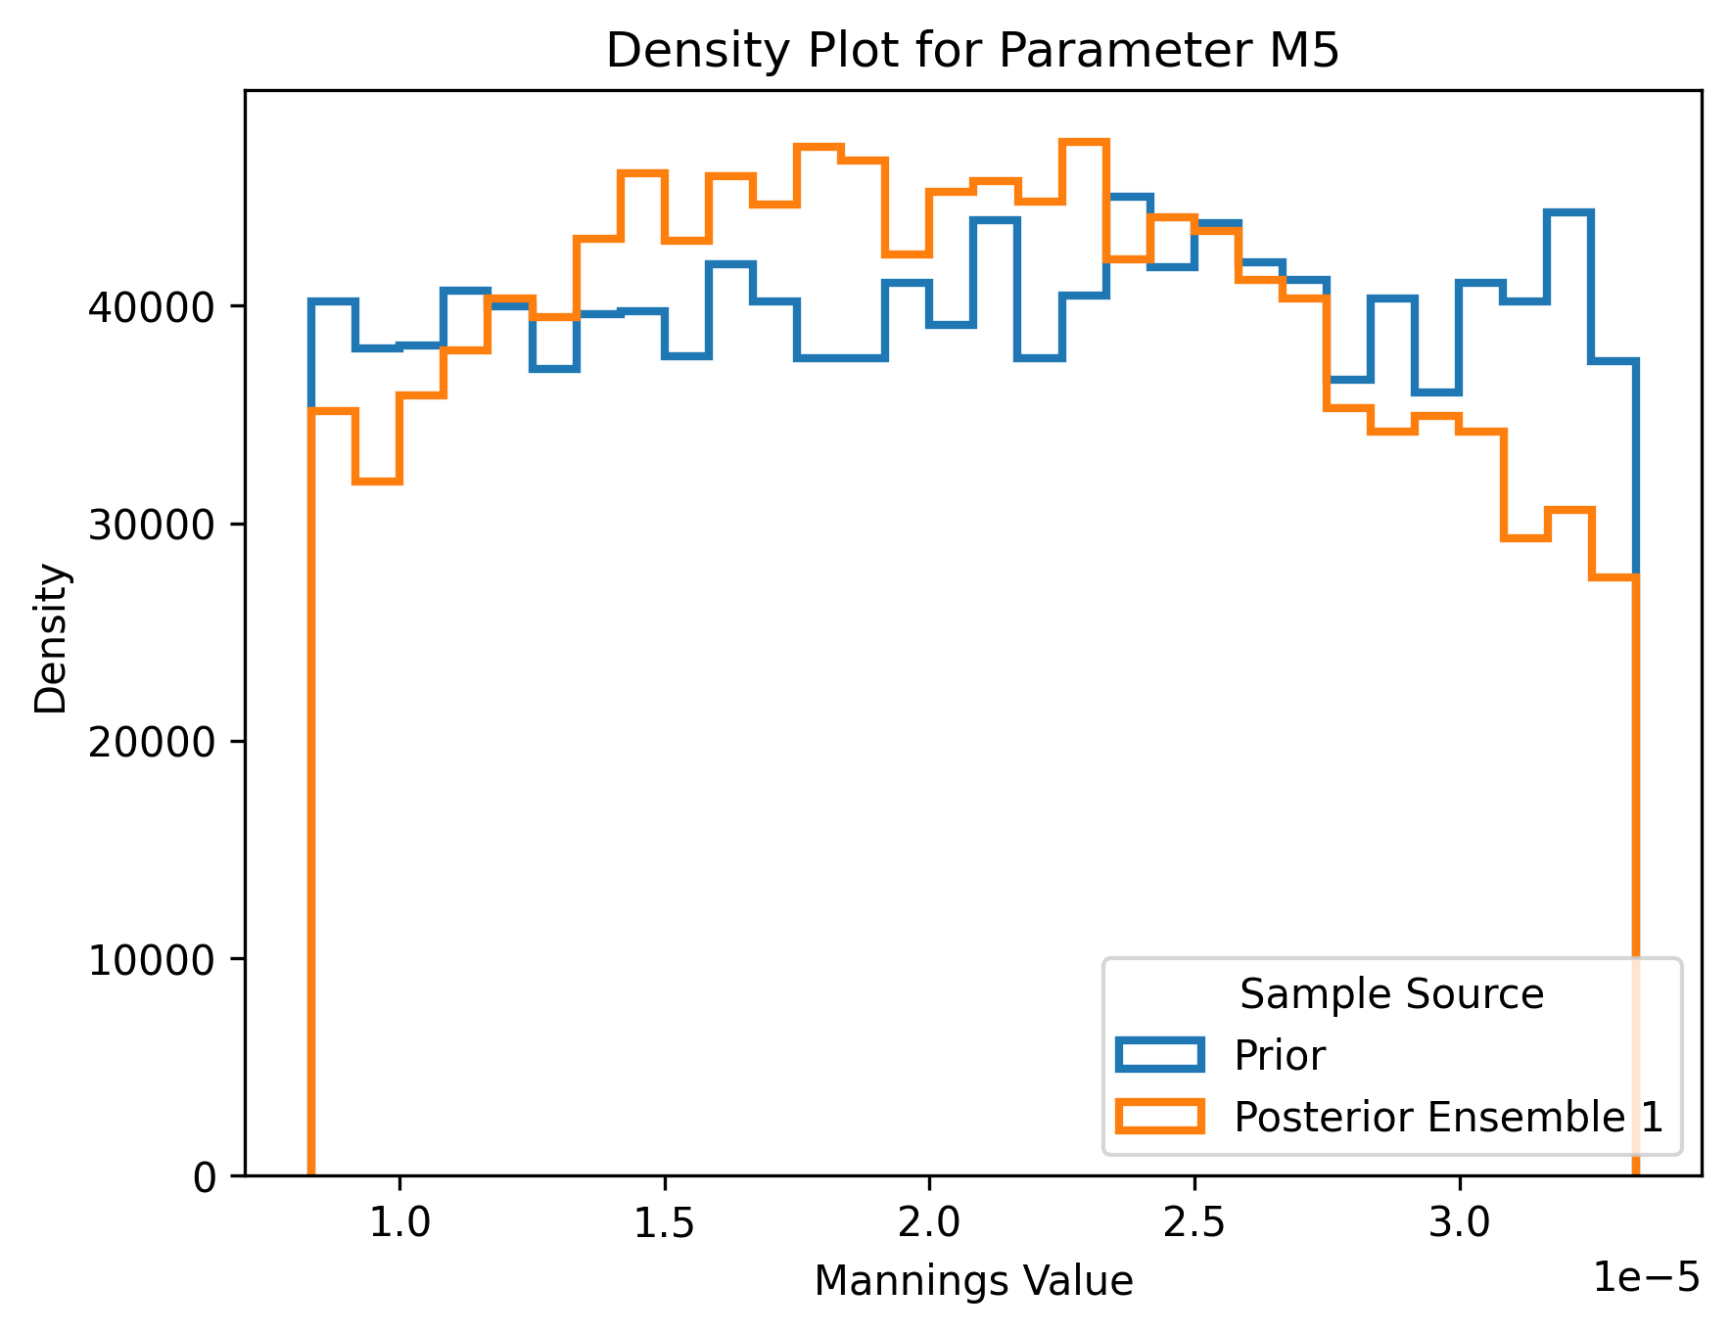
M5: Posterior Distribution
Notes:
Sampling 400 simulations
Posterior distribution that is presented is from the first iteration

Slide 10
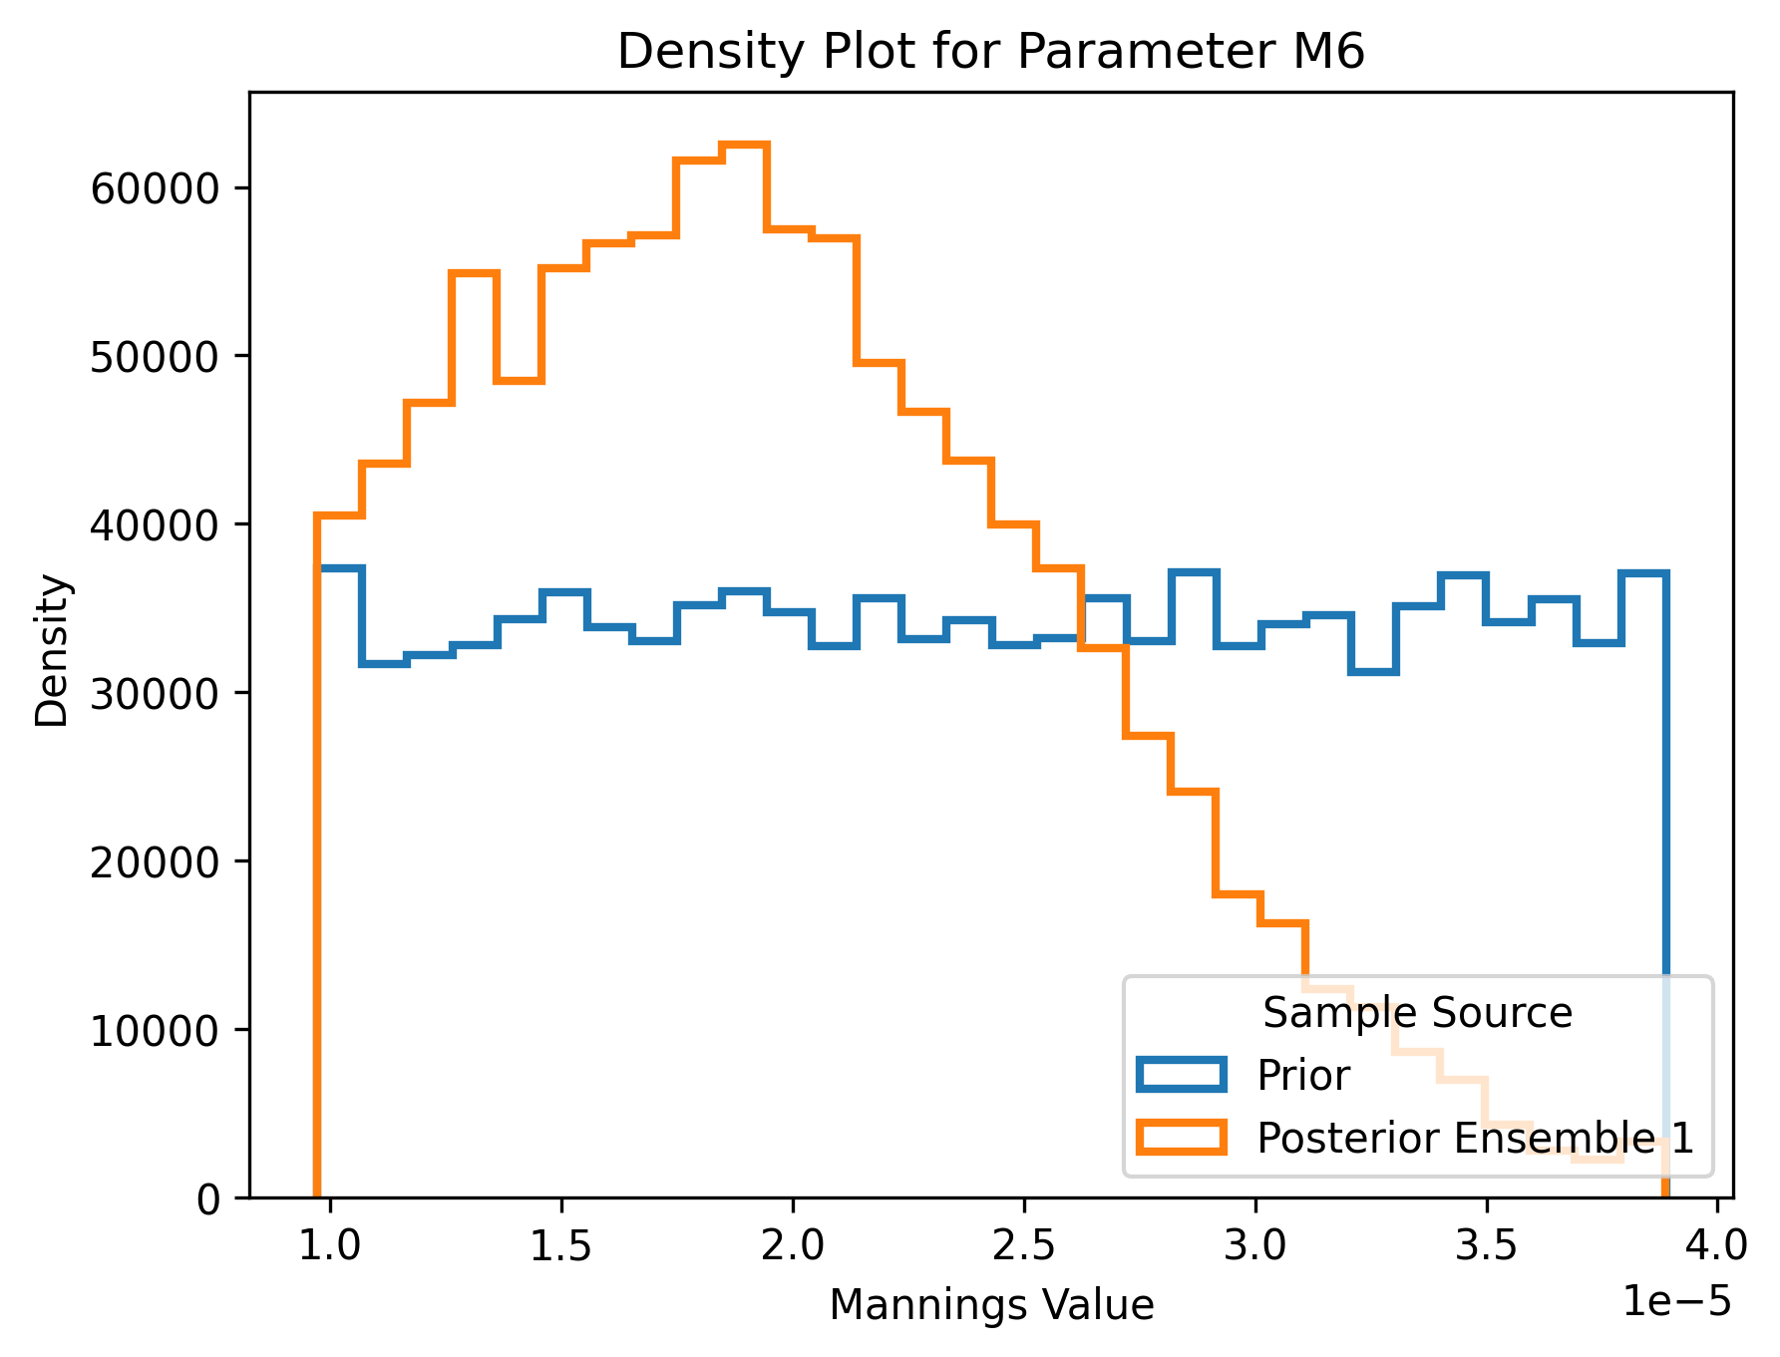
M6: Posterior Distribution
Notes:
Sampling 400 simulations
Posterior distribution that is presented is from the first iteration

Slide 11
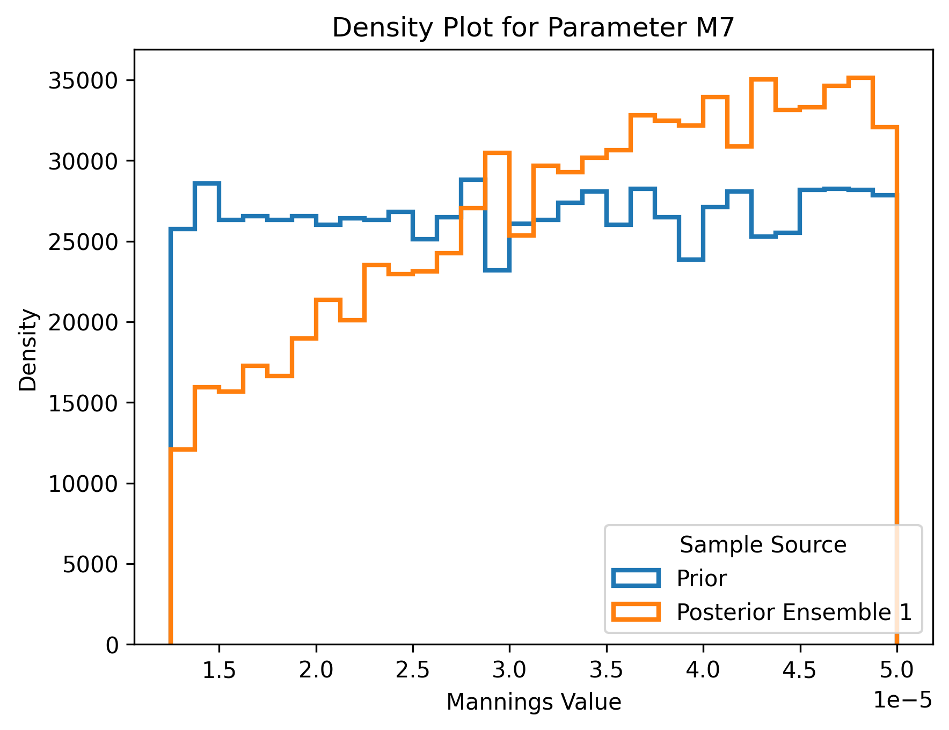
M7: Posterior Distribution
Notes:
Sampling 400 simulations
Posterior distribution that is presented is from the first iteration

Slide 12
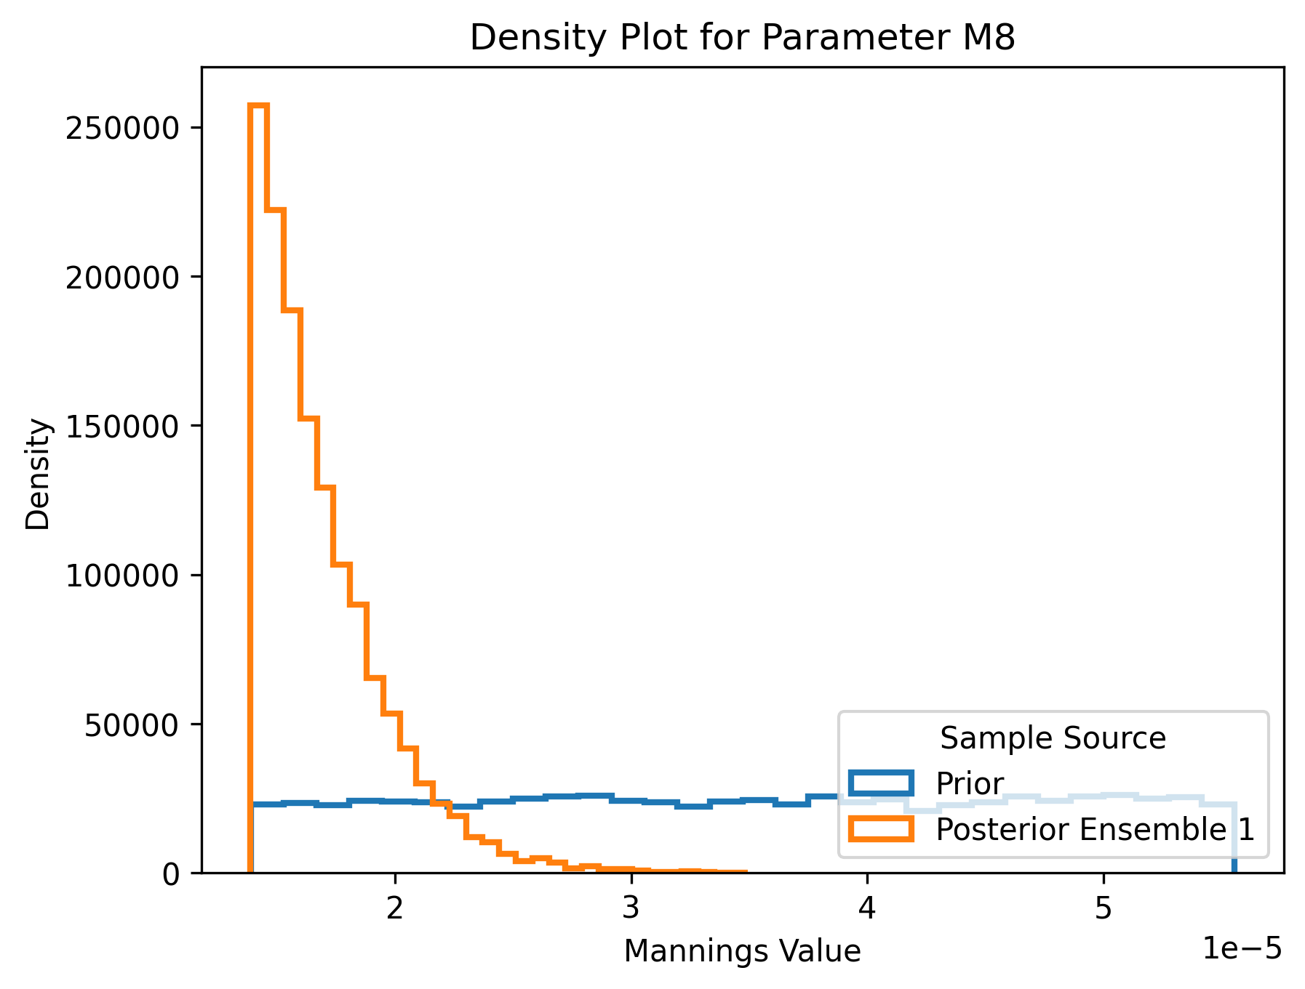
M8: Posterior Distribution
Notes:
Sampling 400 simulations
Posterior distribution that is presented is from the first iteration

Slide 13
Calibrating The Prior Distribution
Increase the Boundaries of the Prior Distribution
Selecting a scalar of 4 instead of 2
Increase the number of simulations

Slide 14
SBI Report
Core Utilization (jupyter notebook)
Written Part (Objective of SBI)
What has been accomplished so far
Next Objective
Buffer time (sequential or parallel)
References section
Citation and references
Notes:
In the objective part do I include the references or I do in text citation or this is not done in grant report
After finishing all these for who I should send my part for double check and editing

